Slide 1
Assembly Guide Compliant Baseball Version

Slide 2
Improvements
Test out different materials
  TPC more elastic less damping
  TPU90A or TPU85A less dense material, so lighter but less stiff
  TPE ??
  VarioShore can change the density and with that change the stiffness
All of them need proper tuning of the print settings in order to print well
Charging connection through the shell
On/off button through the shell
Add encoder

Slide 3
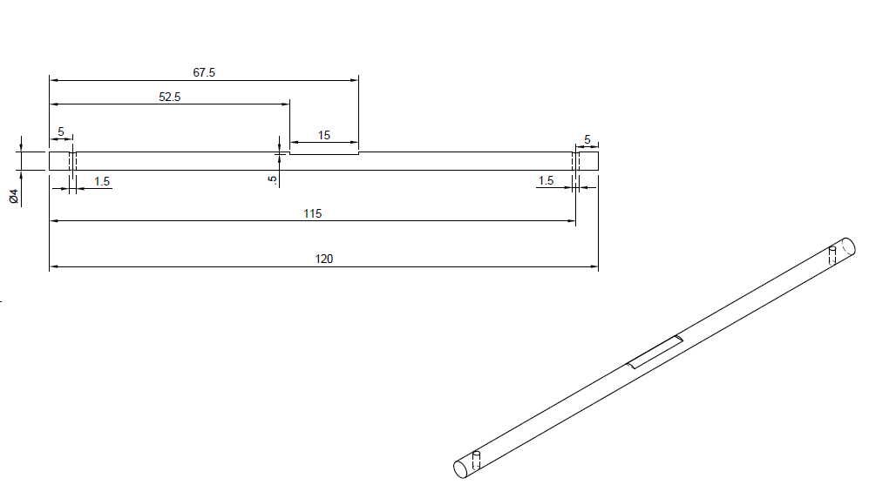
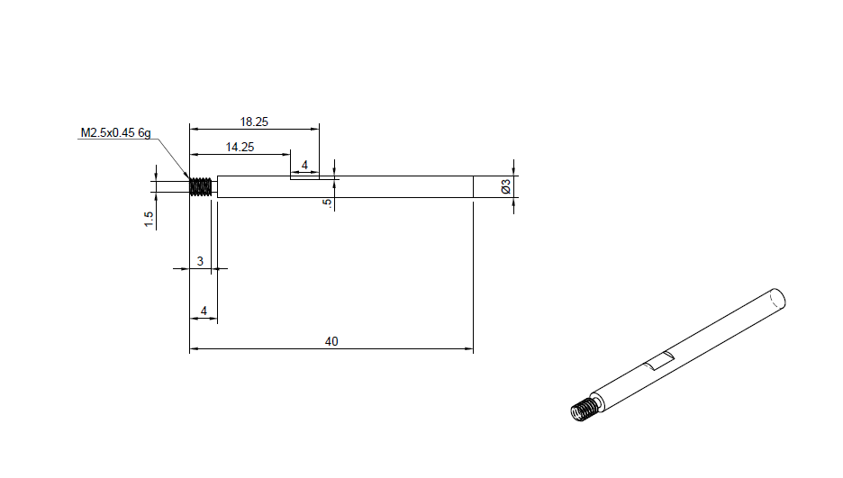
Manufacturing
Making the axes
Follow the technical drawings
The drive axis can be made on a lathe
The fixed axis can be done on a milling machine or by hand with some additional aiding pieces to drill in a round bar

Slide 4
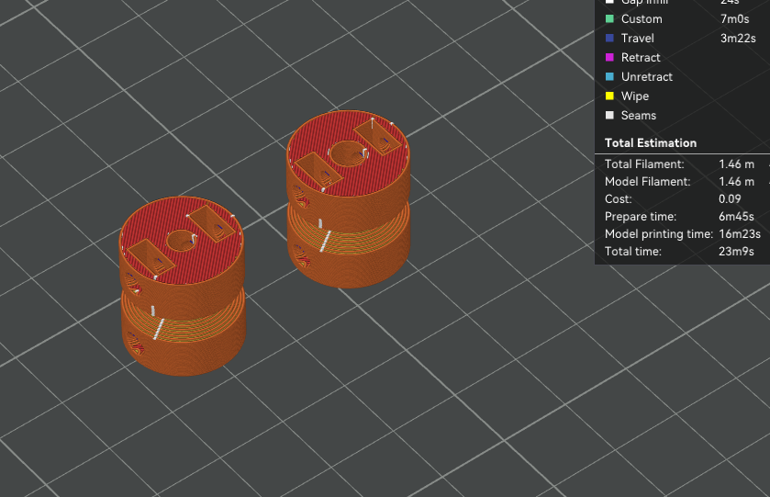
Manufacturing
Printing the pulleys
Print settings
Infill rate is 15%
Could make the center hole a bit smaller and drill to the right size
  This could make the holes more precise and centered
Support can be added to make the v-shape better
Or printed in two halves and glued together
See print settings for PLA (standard settings)

Slide 5
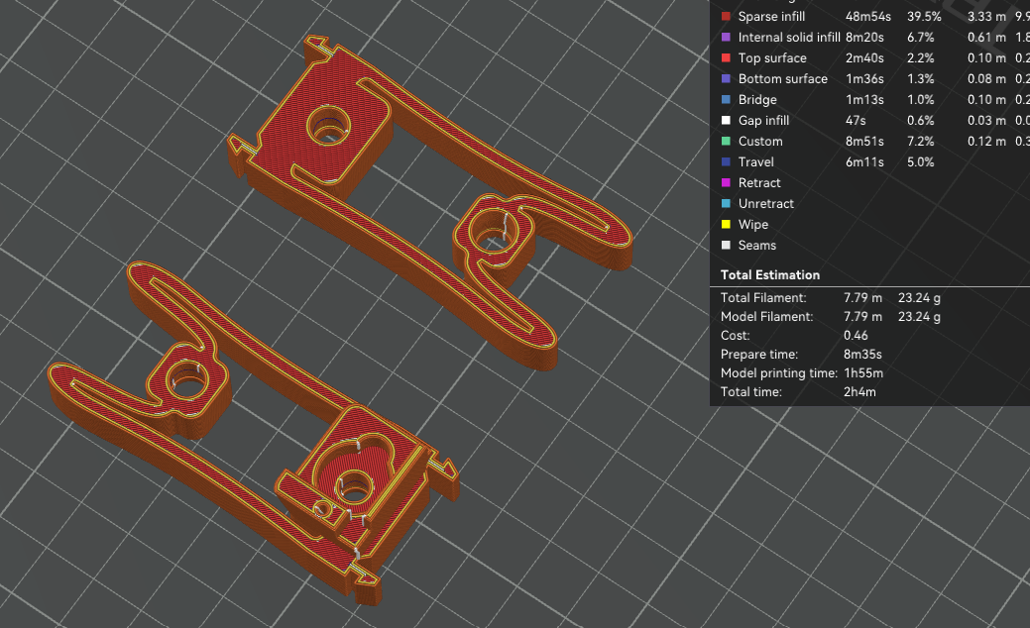
Manufacturing
Printing the CFM snapfit
Print settings
Infill rate is 80%
You can print two at the same time
No support needed
See print settings for TPU 95A

Slide 6
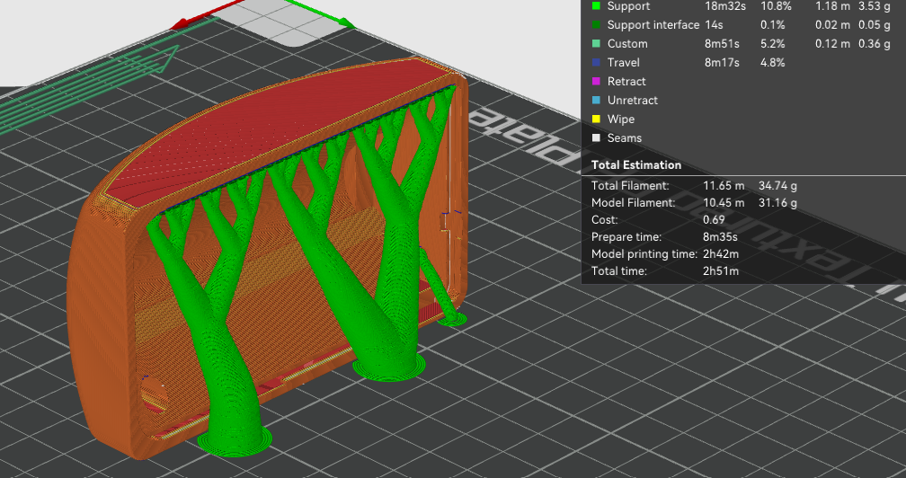
Manufacturing
Printing the bumper
Print settings
Infill rate is 15%
Add support for the top part
See TPU print settings

Slide 7
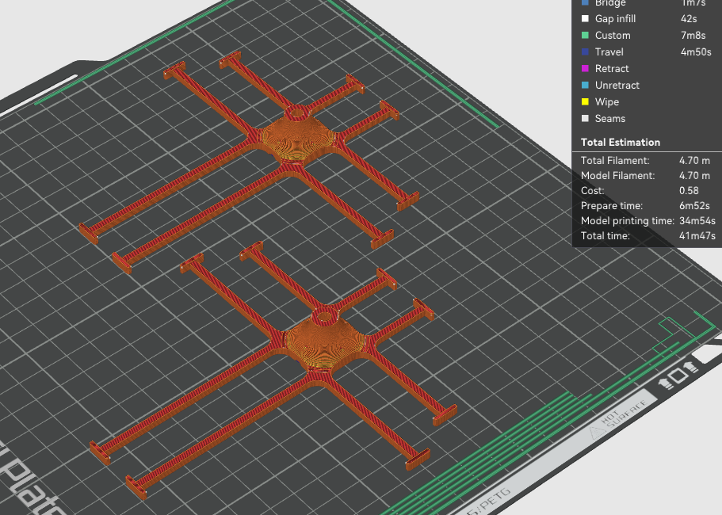
Manufacturing
Printing the suspension
Print settings
Infill rate is 15%
You can print two at the same time (depending on the bed size)
No support needed
See TPU print settings

Slide 8
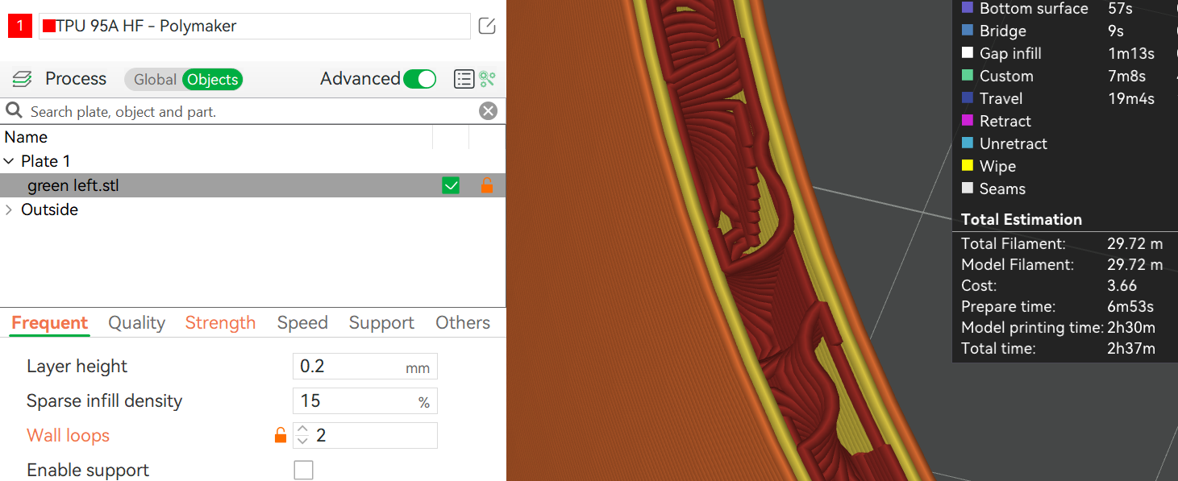
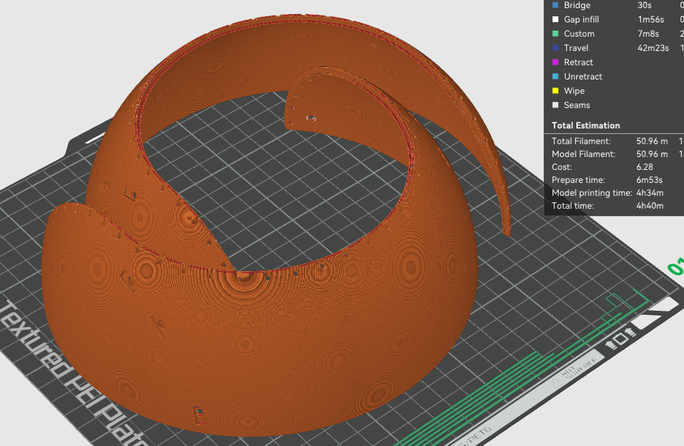
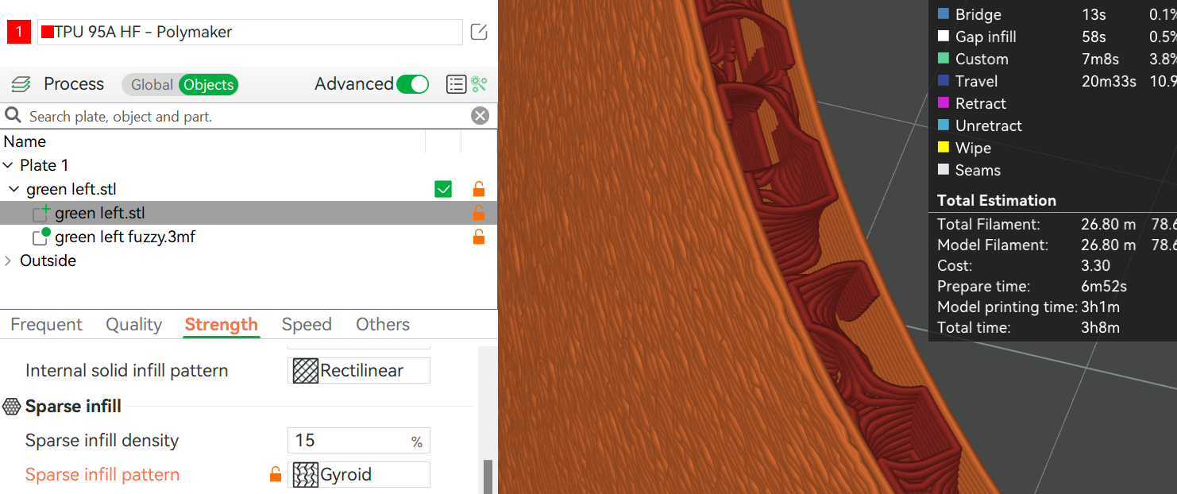
Manufacturing
Printing the shells
Print settings
Infill rate is 15%, pattern: Gyroid
You can print two at the same time
Choose between fuzzy skin or normal 2 wall perimeter
  Normal print settings are more reliable to print
  Fuzzy skin is slightly lighter
  Fuzzy skin adds texture to the surface
See print settings for TPU 95A
  Normal 2 wall perimeter
  With fuzzy skin on outside wall

Slide 9
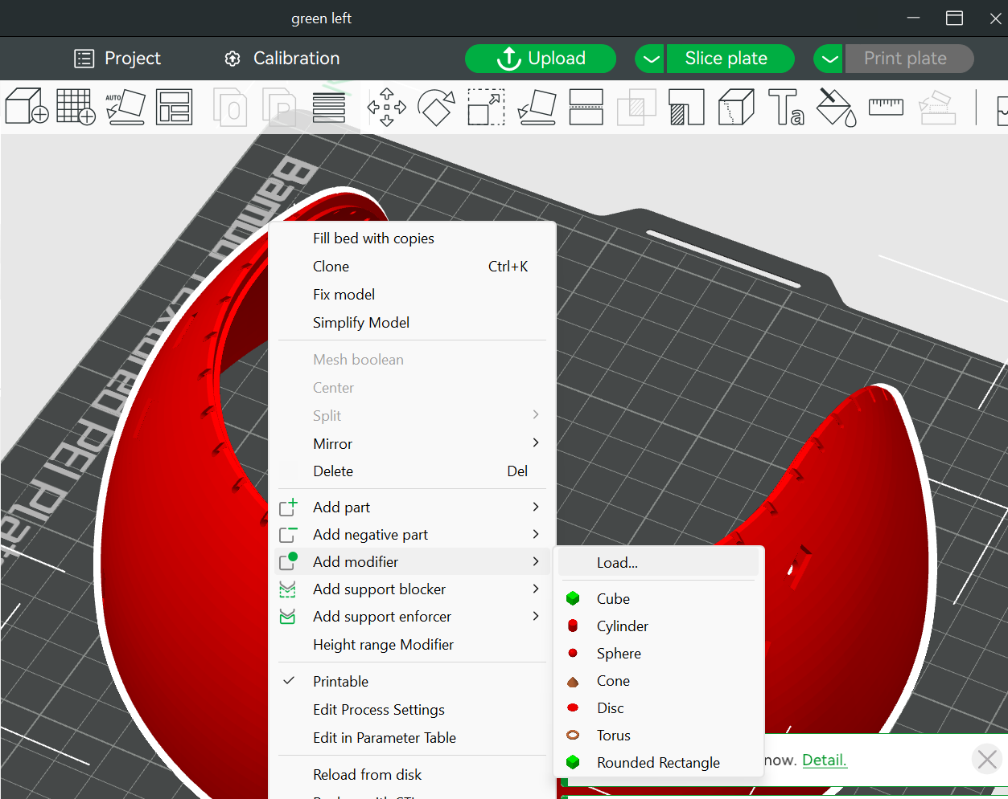
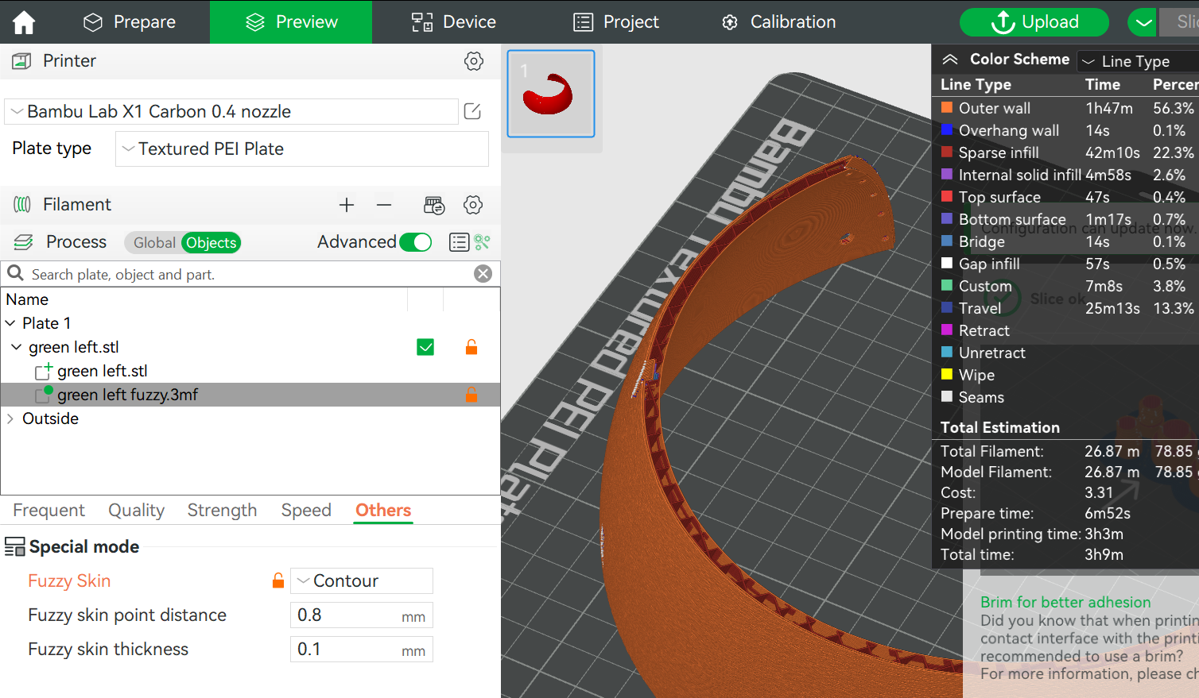
Manufacturing
Printing the shell
Print settings
Fuzzy skin:
Print with 1 wall thickness
Use fuzzy skin to increase the wall thickness on the outside (Use the modifiers in the print folder to get the fuzzy skin only on the outside)
  Load modifier
  Add fuzzy skin

Slide 10
Assembly
Assembly Drivetrain
Solder all the components on the PCB, except for the battery holder!!
Adjust the cable of the servo motor to fit the connector on the PCB
Modify one of the accessories of the servo motor to be used to tighten the drive axis on the motor
Add a little bit of loctide or instant glue to the drive axis thread and attach the drive axis to the motor
Insert the bearings in the CFMs
  Small bearings at the motor
  Large bearings at the fixed axis
Press the CFMs in the PCB
  Make sure it is orientated in the right way
Insert the battery holder and solder it in position
Insert the nut and set screw to both pulleys
Insert the motor with axis through the bearings and make sure to place the pulley and belt in between the CFMs
Insert a screw to attach the servo motor to the CFM
Tighten the set screw in the pulley with a little bit of loctide
Add the bumper
Insert fixed axis through the CFMs with the pulley and belt in between
Tighten the pulley again with a little bit of loctide on the setscrew

Slide 11
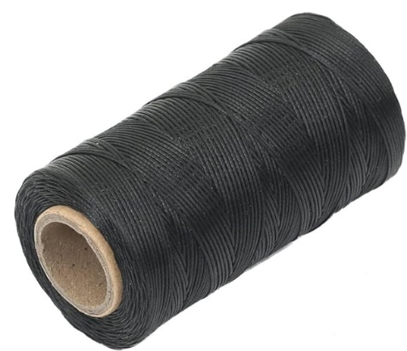
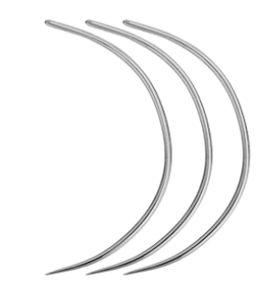
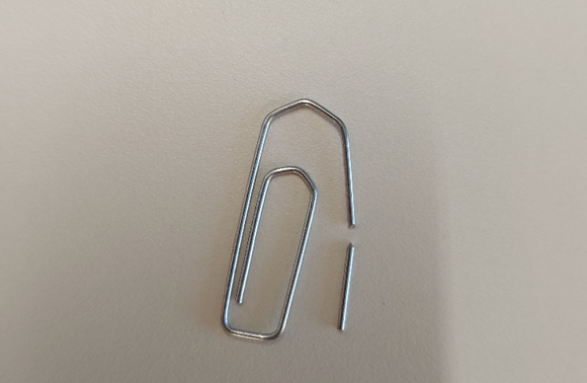
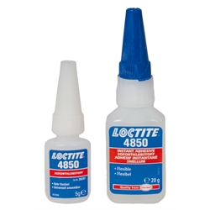
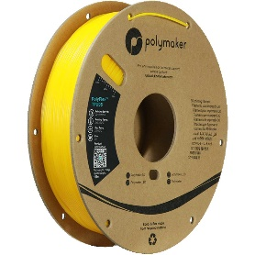
Assembly
Assembly Half shells
Put alignment pins in one half
Glue shells together with flexible glue, make sure the two halves align
  Don’t use to much glue, hazing will occur (turning white), and the glue will prevent proper welding of the two halves later
  Glue it only to keep it in place for the welding part
Let the glue dry (at least an hour)
Prepare the welding of the two halves
Weld
Let it cool down (at least an hours)

Slide 12
Assembly
Assembly Suspension
Insert the suspension hubs in the shell. Do this by press fitting it through like in the picture

Slide 13
Assembly
Assembly Whole ball
Start stitching the first half of the ball
Connect the suspension hubs to the fixed axis with the drivetrain in the middle
  Use the pins to do so
Finish the stitching of the rest of the ball

